Slide 1

Smart Card Management
INTERNAL – Created by GTB e-Channels Global Training

Slide 2
What are Smart Cards?
Used to enhance the security and authentication process on HSBCnet
A 3rd party provider (GEMPLUS) was chosen by HSBC for the packaged solution
The Smart Cards and Card Readers are sent from GEMPLUS directly to customers

Slide 3
Who will need Smart Cards?
HSBCnet System Administrators (SA) with User Administration entitlements
HSBCnet SA or End Users (EU) with certain transacting entitlements (payment authorisation, payment file upload, etc…)
EU with enquiry access or other “low-risk” entitlements (payment creation, balance enquiry, etc…) will normally not require smart cards

Slide 4
Hardware & Software Requirements

Slide 5
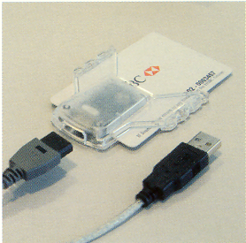
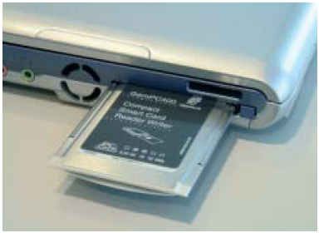
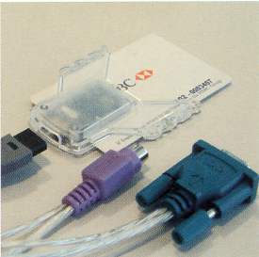
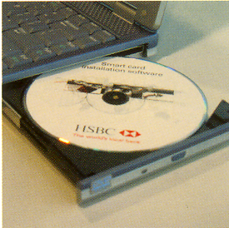
Smart Card Readers / Software
USB
PC CARD (PCMCIA)
Serial / PS2
There are three types of Smart Card Readers available:
The Gemsafe software CD is packaged with the smart card reader, this software is required to be installed in order to register the smart card certificates.

Slide 6
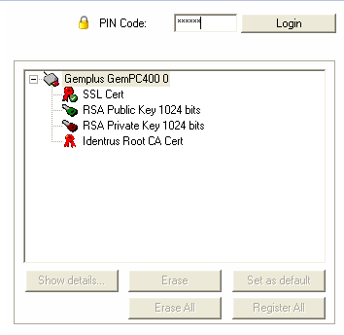
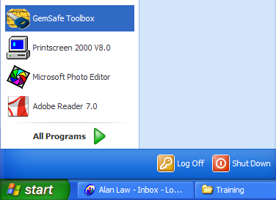
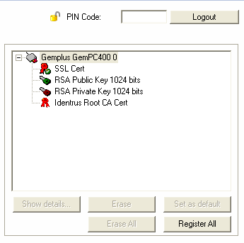

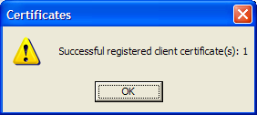
Smart Card Certificate Registration
Input the PIN for your Smart card
Click on Register All
Click on Certificates

Slide 7

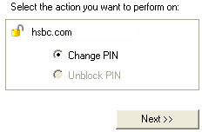
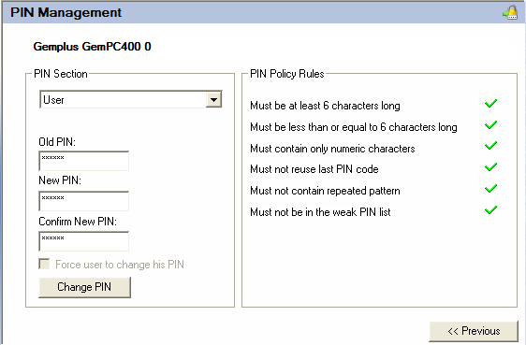
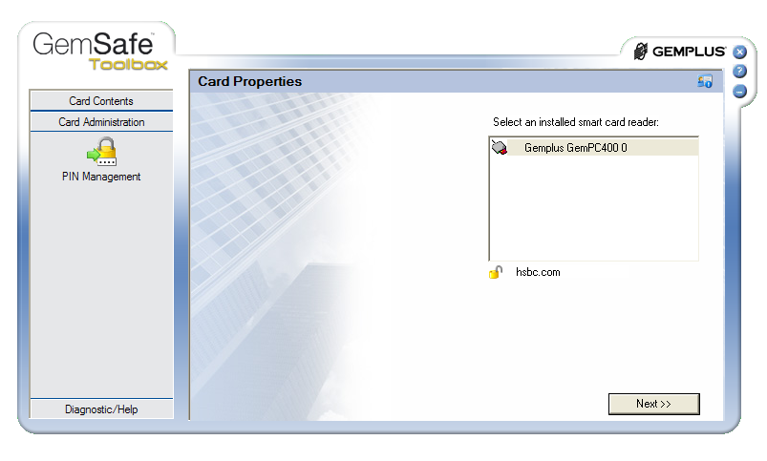
Change Smart Card PIN
Input the current PIN and input the new PIN twice. Note the PIN has to meet all criteria before you can confirm the changes.
Click on Card Administration and PIN Management

Slide 8
What are the tools?

Slide 9
HSBCnet Smart Card Management Functions
The Smart Card Management functions on HSBCnet can by accessed by clicking the “Manage Smart Cards” link under the User Management Tool (UMT)
Functions Include:
Query Smart Card Information
Replace Smart Card
Revoke Smart Card
Additional Reader/Software
Smart Card Expiry Report
Issue Smart Card

Slide 10
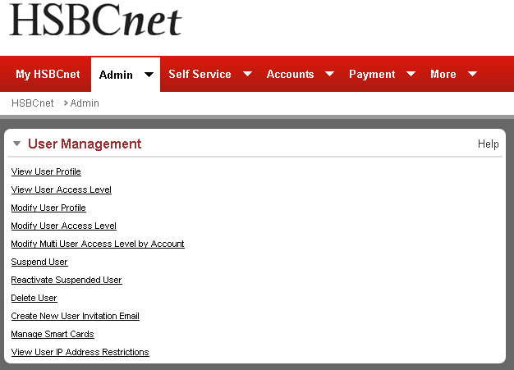
HSBCnet Smart Card Management Functions
As with all User Management tools, clicking “Manage Smart Cards” will require User authentication to proceed

Slide 11
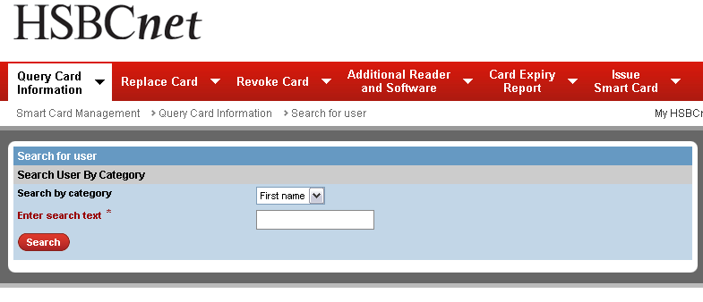
HSBCnet Smart Card Management Functions
All smart card functions can be accessed using the tabs along the top of the screen for quick access

Slide 12
Query Smart Card Information – How does it work? –

Slide 13
Query Smart Card Information
Used by System Administrators to query detailed information of a smart card assigned to a specific user
Details include:
Shipment details of the latest request for a smart card and PIN
Details of latest request of a smart card reader or software

Slide 14
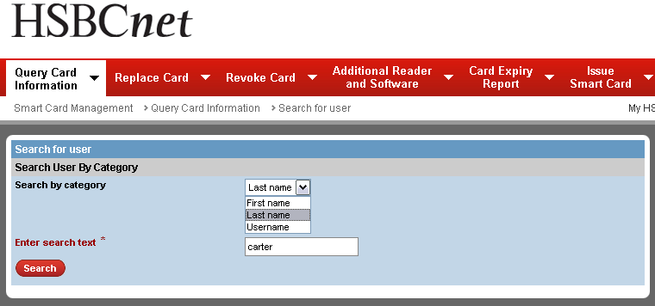
Query Smart Card Information
Select the search category using the drop-down menu and then enter the value to search for in the field below
Click search and the results will display below

Slide 15
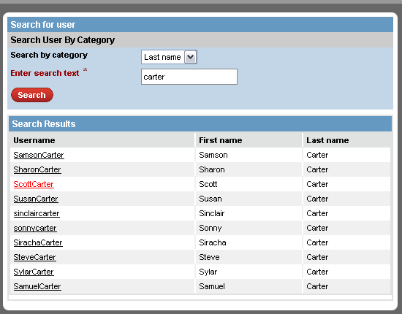
Query Smart Card Information
Click the last name to view the smart card details

Slide 16
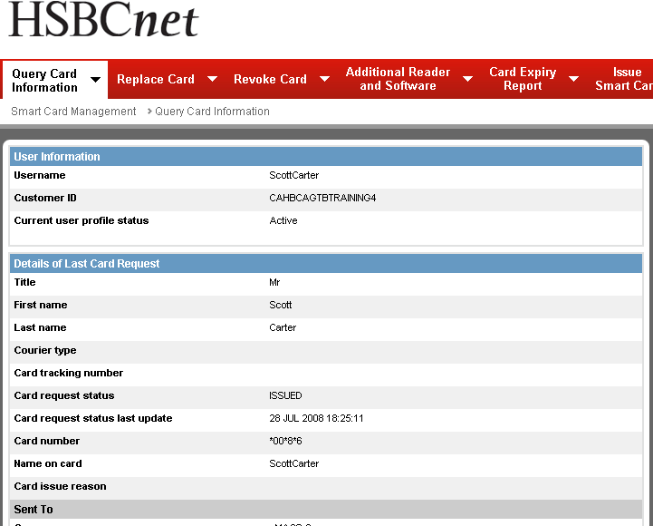
Query Smart Card Information
The information displayed will provide the details of the last card, pin, and card reader request

Slide 17
Replace Smart Card – How does it work? –

Slide 18
Replace Smart Card
Allows a System Administrator (SA) to request a replacement smart card for another SA or an end user (EU) within their customer profile
Once submitted (and authorised if required) replacement smart card requests cannot be cancelled
Once a replacement smart card request is submitted, the existing smart card assigned to the user will be revoked immediately
Replacement requests will require final authorisation if the Customer profile is set to ‘Dual’ authority

Slide 19
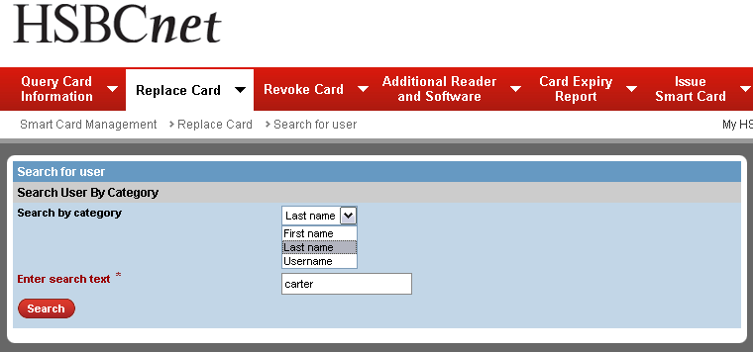
Replace Smart Card
Select the search category using the drop-down menu and then enter the value to search for in the field below
Click search and the results will display below

Slide 20
Replace Smart Card
Click the last name to view the smart card details

Slide 21
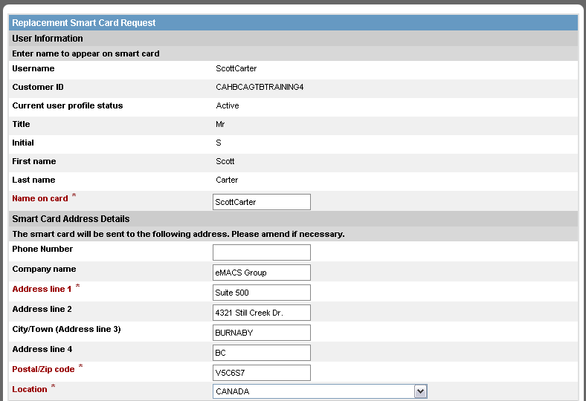
Replace Smart Card
Specify the name that will appear on the smart card. And then verify the shipping address for the card below
Scroll down to verify the PIN address details

Slide 22
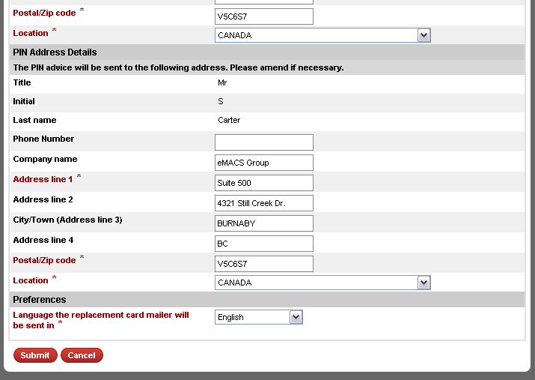
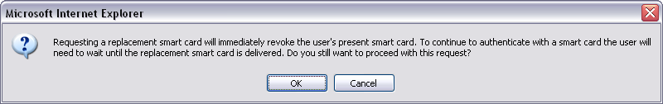
Replace Smart Card
Verify the address for where the PIN will be shipped to. Note: The card and PIN addresses do not have to match
Once submitted, a pop-up box will appear advising that the existing smart card will be revoked immediately when the request is submitted. Click “OK” to confirm.
Click to submit the request

Slide 23
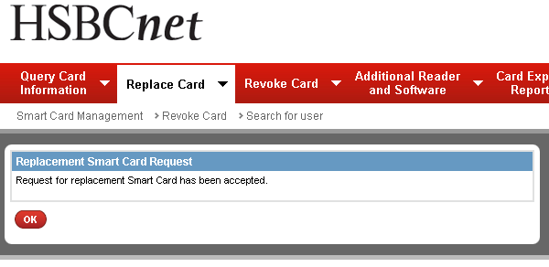
Replace Smart Card
Once confirmed, the user’s existing smart card will be revoked and that user will not be able to authenticate their session until they receive their new card and PIN.
Note: If the customer profile is set to “DUAL” authority, the request will need to be approved by another SA before it is processed

Slide 24
Revoke Smart Card – How does it work? –

Slide 25
Revoke Smart Card
Allows a System Administrator (SA) to revoke a user’s smart card.
Once a smart card is revoked, the process cannot be reversed and a replacement smart card must be ordered should the user require it
If a customer’s profile is set to ‘Dual’ authority, requests will require final authorisation before a smart card is revoked.

Slide 26
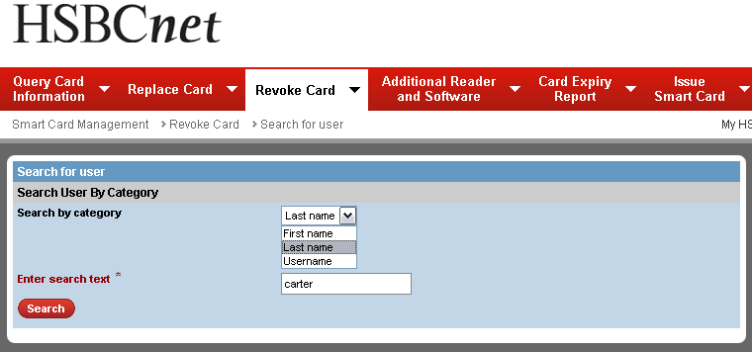
Revoke Smart Card
Select the search category using the drop-down menu and then enter the value to search for in the field below
Click search and the results will display below

Slide 27
Revoke Smart Card
Click the last name to view the smart card details

Slide 28
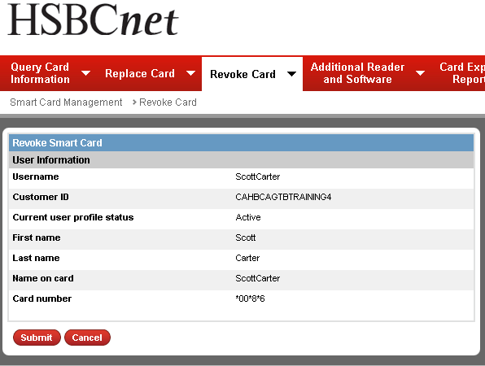
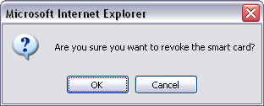
Revoke Smart Card
Click to confirm the revocation request
Click to submit the request to revoke the user’s smart card

Slide 29
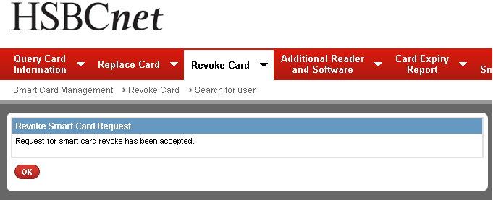
Revoke Smart Card
If the customer profile is set to “DUAL” authority, the request will need to be approved by another SA before the smart card is revoked

Slide 30
Additional Reader/Software – How does it work? –

Slide 31
Additional Reader/Software
Used by a System Administrator (SA) to order additional smart card readers and software (if needed)
Requests for additional readers and software does not require authorisation

Slide 32
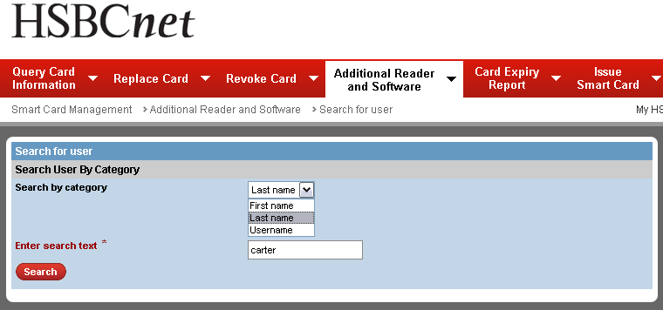
Additional Reader/Software
Select the search category using the drop-down menu and then enter the value to search for in the field below
Click search and the results will display below

Slide 33
Additional Reader/Software
Click the last name to view the smart card details

Slide 34
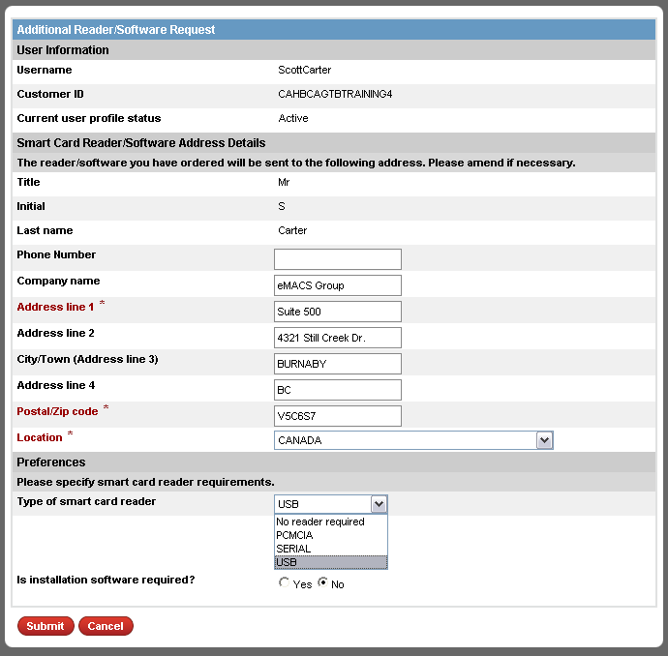
Additional Reader/Software
Verify the address where the reader and/or software will be shipped to.
Select the type of smart card reader and if the software CD is required
Click to submit the request

Slide 35
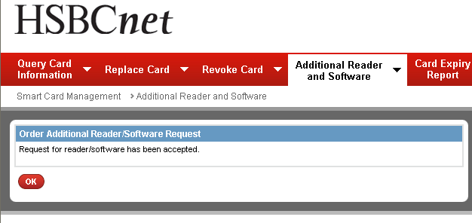
Additional Reader/Software
If the customer profile is set to “DUAL” authority, the request will need to be approved by another SA before the order is processed

Slide 36
Smart Card Expiry Report – How does it work? –

Slide 37
Smart Card Expiry Report
The Smart Card Expiry Report provides System Administrators with a report detailing all cards due to expire within the next 45 calendar days.
Staff Users also have access to the Expiry Reports
When System Administrators access the Smart Card Expiry Report function, they will automatically be provided a list of the smart cards expiring within the next 45 days.
When Staff Users access the Smart Card Expiry Report function, they will be able to use the search tool to enquire on different customers
Search function is available to Staff Users only. Customers will not have any search capability for smart card expiry reports.

Slide 38
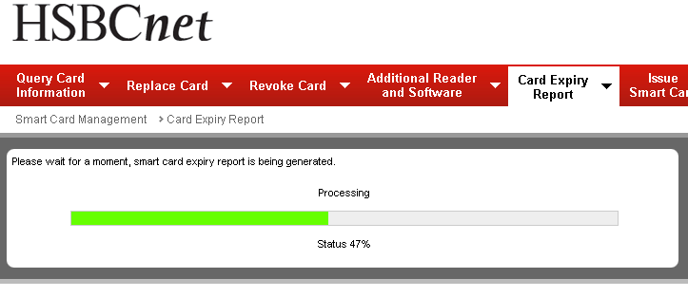
Smart Card Expiry Report – Customer SA View
For a Customer’s system administrator, when launching the card expiry report, the system will begin generating the report automatically

Slide 39
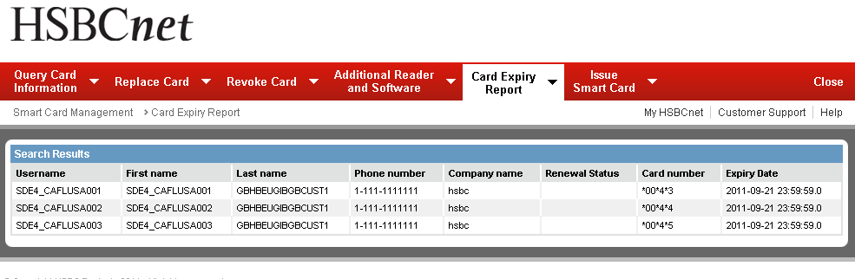
Smart Card Expiry Report – Customer SA View
The report will list the users with smart cards expiring within the next 45 calendar days

Slide 40
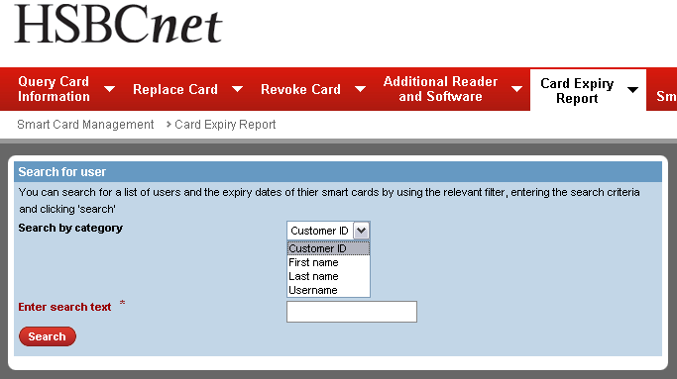
Smart Card Expiry Report – Staff User View
For bank Staff Users, a search option will be available to enquiry on the expiry dates of specific users and entire customer profiles

Slide 41
Issue Smart Card – How does it work? –

Slide 42
Issue Smart Card
The “Issue Smart Card” function is used by a System Administrator (SA) to order/request a new smart card for a user when the issuance of a smart card was not completed (skipped) during the initial set up that user.
Issue Smart Card cannot be used to replace an existing smart card.
If a user already has an existing card and requires a replacement smart card. Use the “Replace Smart Card” function.

Slide 43
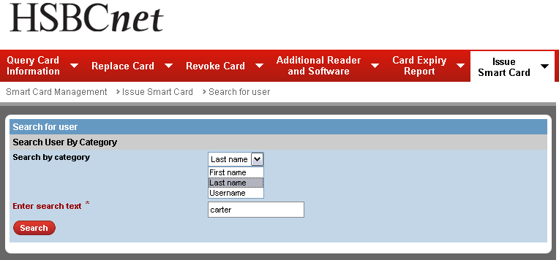
Issue Smart Card
Select the search category using the drop-down menu and then enter the value to search for in the field below
Click search and the results will display below

Slide 44
Issue Smart Card
Click the last name to view the smart card details

Slide 45
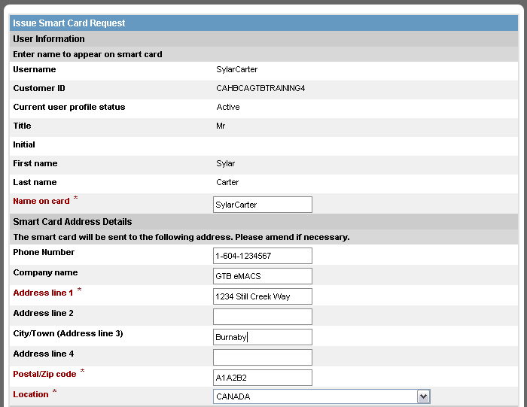
Issue Smart Card
Specify the name that will appear on the smart card. And then verify the shipping address for the card below
Scroll down to verify the PIN address details

Slide 46
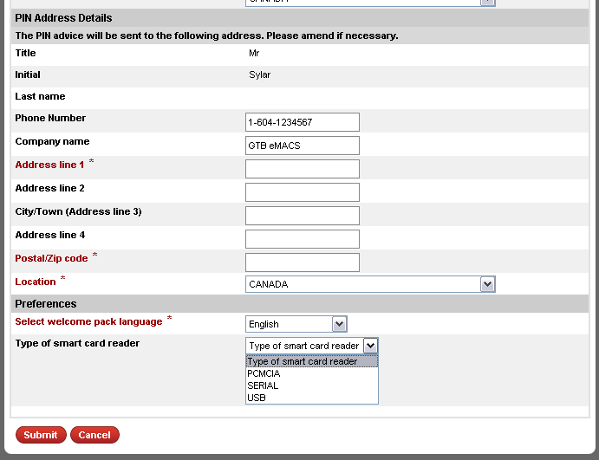
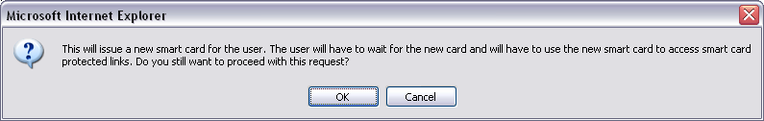
Issue Smart Card
Verify the address for where the PIN will be shipped to. Note: The card and PIN addresses do not have to match
Once submitted, a pop-up box will appear advising that the user will need to wait for their new card before they can access smart card protected tools. Click “OK” to confirm.
Select the welcome pack language and the type of smart card reader required.
Click to submit the request

Slide 47
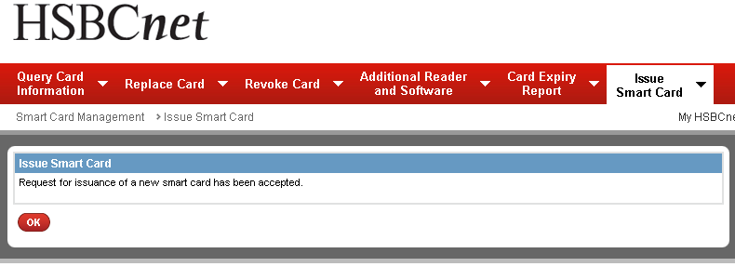
Issue Smart Card
If the customer profile is set to “DUAL” authority, the request will need to be approved by another SA before the new smart card is issued

